Slide 1
CLT and Normal dist

Slide 2
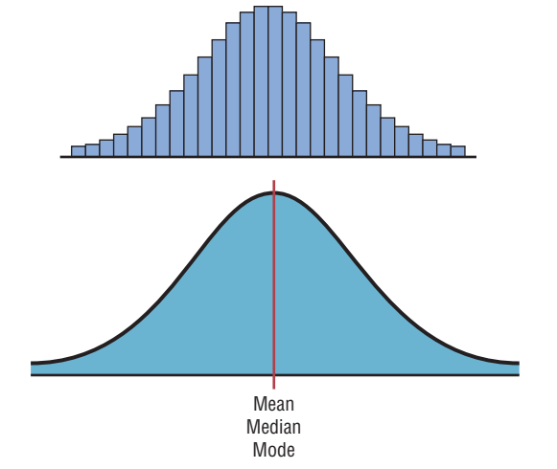
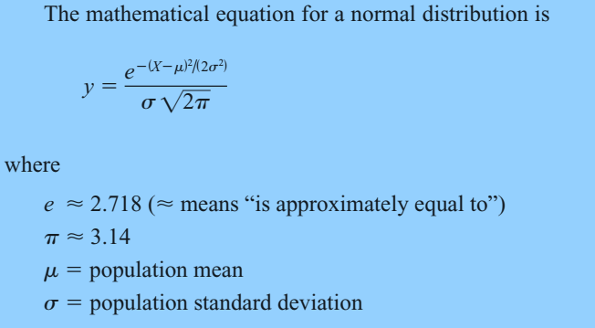
Normal / Gaussian Distribution

Slide 3
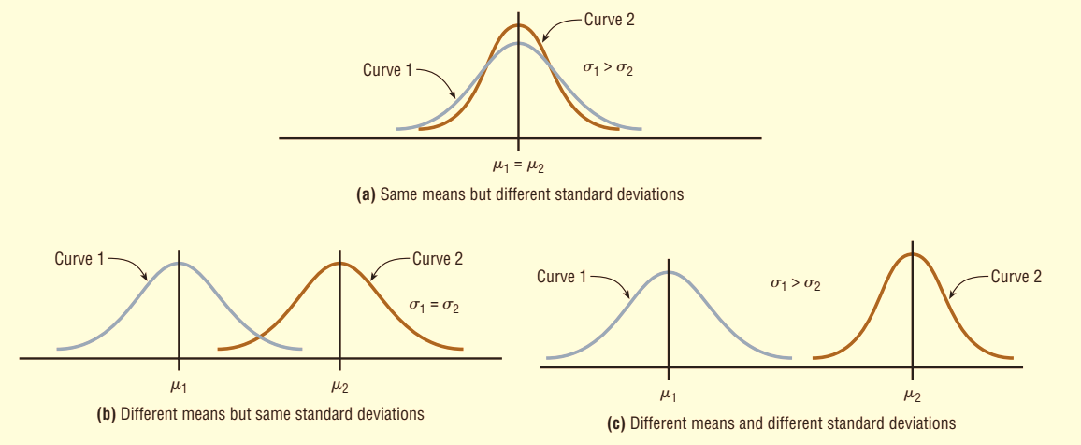
Shapes of Normal Distribution

Slide 4
Properties of Normal Distribution
A normal distribution is bell-shaped, symmetric and unimodal.
Mean = Median = Mode
The curve never touches the x axis. Theoretically, no matter how far in either direction the curve extends, it never meets the x axis—but it gets increasingly closer.
The total area under a normal distribution curve is equal to 1.00, or 100%.
The area under the part of a normal curve that lies within 1 standard deviation of the mean is approximately 0.68, or 68%; within 2 standard deviations, about 0.95, or 95%; and within 3 standard deviations, about 0.997, or 99.7%.

Slide 5


The Standard Normal Distribution
The standard normal distribution is a normal distribution with a mean of 0 and a standard deviation of 1.
The formula for the standard normal distribution is:
All normally distributed variables can be transformed into the standard normally distributed variable by using the formula for the standard score:
Notes:
The z score is actually the number of standard deviations that a particular X value is away from the mean.

Slide 6
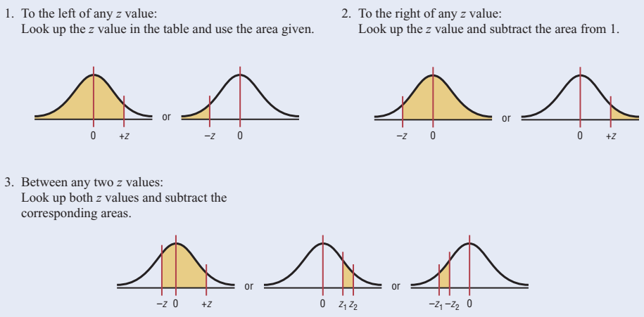
Areas under the standard Normal Curve

Slide 7

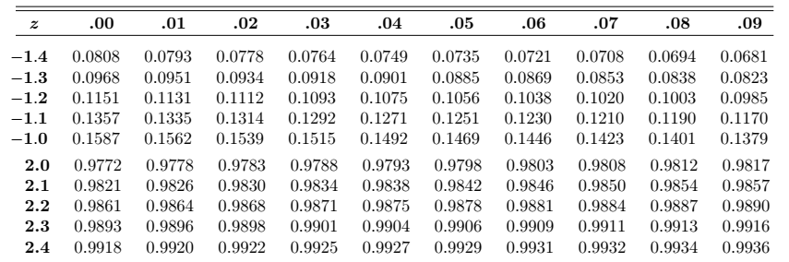
Example 01
Find the area to the left of z = 2.06
Find the area to the right of z = -1.19
Find the area between z = 1.68 and z = -1.37
Notes:
Incomplete Standard Normal table
P(z>-1.19) = 1 – 0.1170 = 0.8830
P(-1.37< z < 1.68) = 0.9535 – 0.0853 = 0.8682
The area under the standard normal distribution curve can also be thought of as a probability.

Slide 8
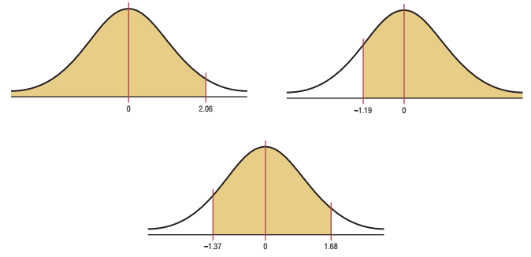
Example 01 (Contd.)

Slide 9
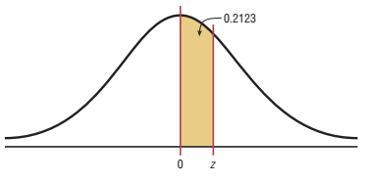
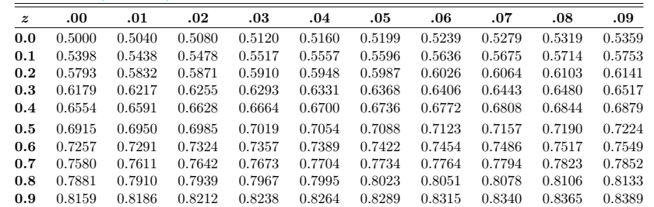
Example # 02
Find the z value such that the area under
the standard normal distribution curve b/w
0 and the z value is 0.2123.
Notes:
it is necessary to add 0.5000 to the given area of 0.2123 to get the cumulative area of 0.7123.

Slide 10
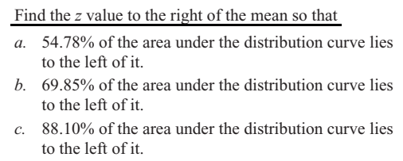
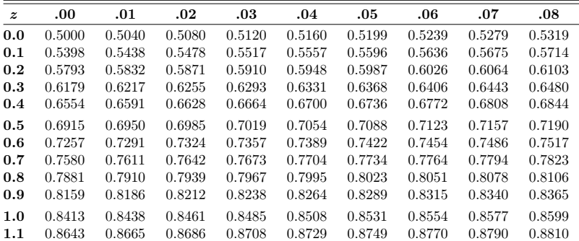
Example # 03:
Notes:
(a) 0.12 (b) 0.52 (c) 1.18

Slide 11
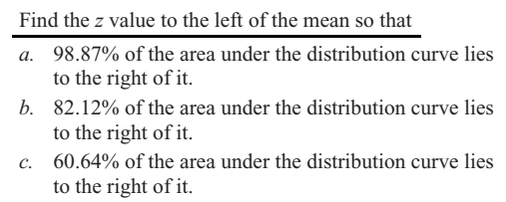
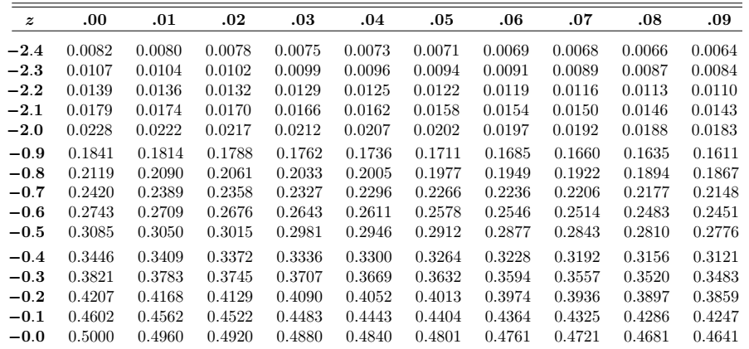
Example # 04:
Notes:
(a) 1 – 0.9887 = 0.0013 (z=-2.28) (b) 1 – 0.8212 = 0.1788 (z=-0.92) (c) 1 – 0.6064 = 0.3936 (z= -0.27)

Slide 12
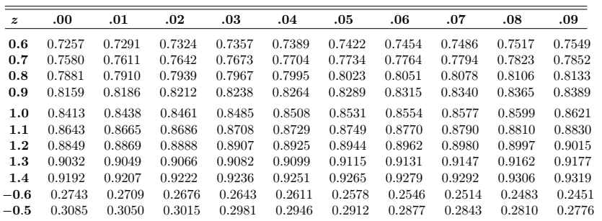
Example # 05
In the standard normal distribution, find the values of z for the 75th, 80th, and 92nd percentiles.
Notes:
(a) Z = +0.64 & -0.64. (Find two z values so that 48% of the middle area is bounded by them. )
(b) 0.67; 0.8416; 1.41

Slide 13
Example # 06 – 07
Summer Spending: A survey found that women spend on average $146.21 on beauty products during the summer months. Assume the standard deviation is $29.44. Find the percentage of women who spend less than $160.00. Assume the variable is normally.
Monthly Newspaper Recycling: Each month, an American household generates an average of 28 pounds of newspaper for garbage or recycling. Assume the standard deviation is 2 pounds. If a household is selected at random, find the probability of its generating:
a. Between 27 and 31 pounds per month b. More than 30.2 pounds per month
Notes:
Z = 0.47 (0.6808)
(a) Z = -0.6 & 1.5 🡪 0.6247

Slide 14
Example # 08 – 10
Coffee Consumption: Americans consume an average of 1.64 cups of coffee per day. Assume the variable is approximately normally distributed with a standard deviation of 0.24 cup. If 500 individuals are selected, approximately how many will drink less than 1 cup of coffee per day?
Police Academy Qualifications: To qualify for a police academy, candidates must score in the top 10% on a general abilities test. The test has a mean of 200 and a standard deviation of 20. Find the lowest possible score to qualify. Assume the test scores are normally distributed
Find K: Given a standard normal distribution, find the value of k such that (a) P (Z > k) = 0.3015 and (b) P (k < Z < -0.18) = 0.4197.
Notes:
(8) Z = -2.67 (500* 0.0038=1.9)
[9] the test value X that cuts off the upper 10% of the area under a normal distribution curve is desired (1 – 0.1000 = 0.9000) 🡪 Z=1.28 (X = 226)
K=-0.52 & for (b) k = -2.37 (find all area below z=-0.18=0.4286)🡪0.4286-0.4197=0.0089

Slide 15
Example # 11
In an industrial process, the diameter of a ball bearing is an important measurement. The buyer sets specifications for the diameter to be 3.0 ± 0.01 cm. The implication is that no part falling outside these specifications will be accepted. It is known that in the process the diameter of a ball bearing has a normal distribution with mean μ = 3.0 and standard deviation σ = 0.005. On average, how many manufactured ball bearings will be scrapped?
Notes:
(2.99 < x < 3.01)=P(-2.0 < z < 2.0) Now [P(Z < -2.0) + P(Z > 2.0) = 2(0.0228) = 0.0456. or 4.56% will be scrapped.

Slide 16
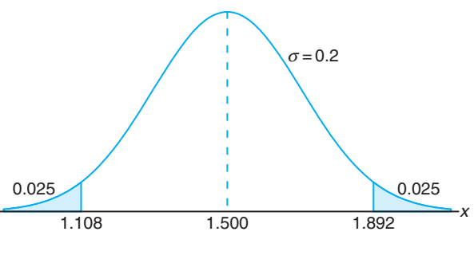
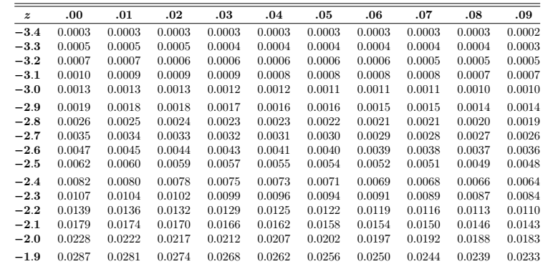
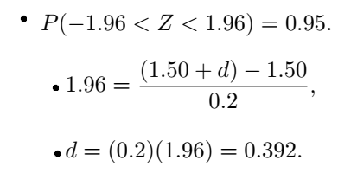
Example # 12
Gauges are used to reject all components for which a certain dimension is not within the specification 1.50 ± d. It is known that this measurement is normally distributed with mean 1.50 and standard deviation 0.2. Determine the value d such that the specifications “cover” 95% of the measurements.
Notes:
1-0.95=0.05 and 0.05/2=0.025 search for 0.025 in z-table that is correspond to -1.96

Slide 17
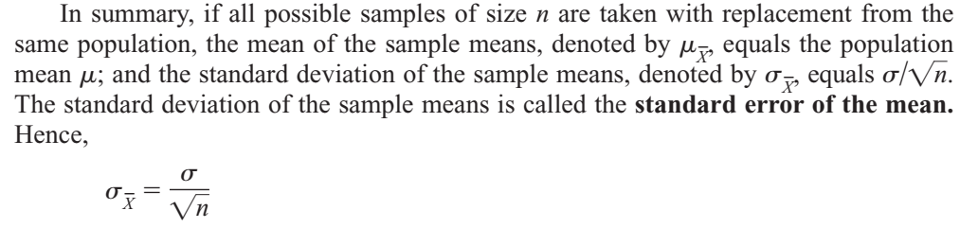
Example # 01 (Sampling distribution of sample means)
Notes:
Sample mean = 5 and sample SD = 1.581

Slide 18

Central Limit Theorem
As the sample size n increases without limit, the shape of the distribution of the sample means taken with replacement from a population with mean µ and standard deviation σ will approach a normal distribution. As previously shown, this distribution will have a mean µ and a standard deviation
If the sample size is sufficiently large, the central limit theorem can be used to answer questions about sample means in the same manner that a normal distribution can be used to answer questions about individual values. The only difference is that a new formula must be used for the z values. It is

Slide 19
Central Limit Theorem (Contd.)
It’s important to remember two points when you use the central limit theorem: 1. When the original variable is normally distributed, the distribution of the sample means will be normally distributed, for any sample size n. 2. When the distribution of the original variable might not be normal, a sample size of 30 or more is needed to use a normal distribution to approximate the distribution of the sample means. The larger the sample, the better the approximation will be.

Slide 20
Example # 02
Hours That Children Watch Television: A. C. Neilsen reported that children between the ages of 2 and 5 watch an average of 25 hours of television per week. Assume the variable is normally distributed and the standard deviation is 3 hours. If 20 children between the ages of 2 and 5 are randomly selected, find the probability that the mean of the number of hours they watch television will be greater than 26.3 hours.
Age of Vehicle: The average age of a vehicle registered in the United States is 8 years, or 96 months. Assume the standard deviation is 16 months. If a random sample of 36 vehicles is selected, find the probability that the mean of their age is between 90 and 100 months
Notes:
Z = 1.94 (0.0262) One can conclude that the probability of obtaining a sample mean larger than 26.3 hours is 2.62%. Z1 = -2.25 & Z2=1.50 (0.9210) the probability of obtaining a sample mean between 90 and 100 months is 92.1%;

Slide 21
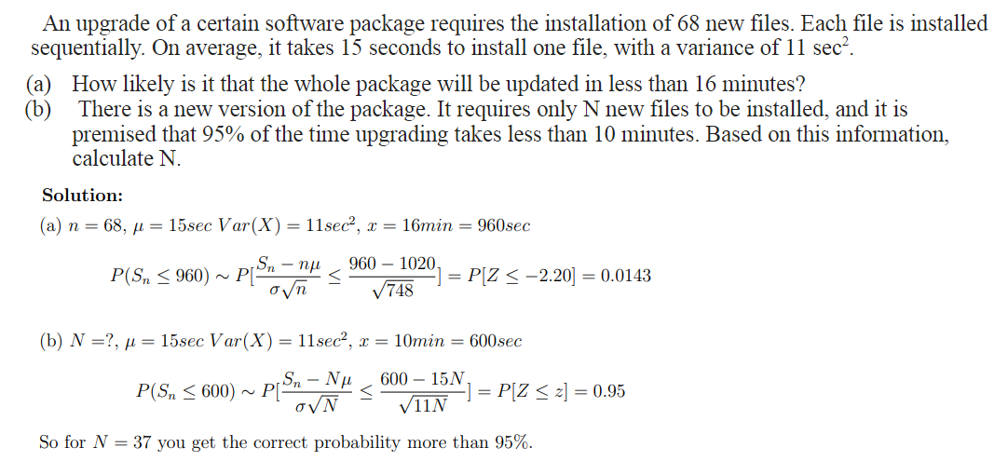
Example 3

Slide 22
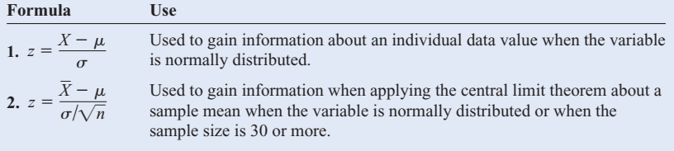
Summary of formulas

Slide 23

Finite Population Correction Factor
The formula for the standard error of the mean is accurate when the samples are drawn with replacement Or are drawn without replacement from a very large or infinite population.
Since sampling with replacement is for the most part unrealistic, a correction factor is necessary for computing the standard error of the mean for samples drawn without replacement from a finite population.
where N is the population size and n is the sample size.
This correction factor is necessary if relatively large samples are taken from a small population, because the sample mean will then more accurately estimate the population mean and there will be less error in the estimation.

